Slide 2
IoT & Big Data
Yolanda Azcunaga
Sergio Guerrero

Slide 3
IoT & Big Data for Dummies
Yolanda Azcunaga
Sergio Guerrero

Slide 4
Session objectives and takeaways
Session objective(s):
Learn about Azure IoT concepts and Microsoft services around this technology.
Introduction to Windows 10 IoT and Raspberry Pi 3.
Understand what we can do with data that we are going to get.
Key takeaways
High-level understanding of the capabilities of the Azure IoT platform.
Insight into how this can be applied in a scenario.

Slide 5
Introduction

Slide 6
Intelligent action
What happened?
Why did it happen?
What will happen?
What should I do?

Slide 7
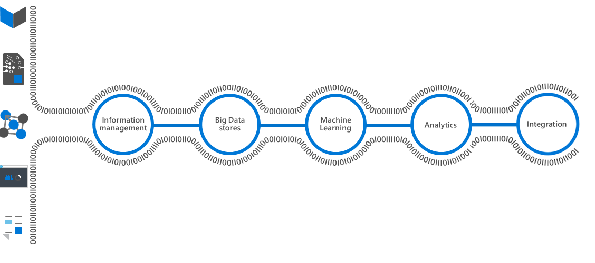
Transform data into intelligent action

Slide 8
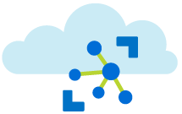




Azure IoT Suite
Information management
Integration with business processes
Analytics
Machine learning
Presentation
Notes:
Antes de empezar vamos a hablar sobre que es Azure IoT.
Hay 5 components clave que forman la suit de Azure IoT. Vamos a ver como se llaman y que hacen y más Adelante entraremos en algo más de detalle en los que vamos a utilizar principalmente.
El primer servicio es IoT Hub. IoT Hub lo utilizamos para conectar y manejar dispositivos de IoT. Lo utilizamos para llevar los datos del dispositivo o de los diferentes sensor a Azure y a partir de ahí poderlos tratar. También se encarga de manejar la seguridad de los dispositivos haciendo la autenticación por certificado para poder conectarse al IoT Hub.
El siguiente Servicio es Stream Analytics. Stream Analytics se utiliza para hacer el stream de datos de IoT Hub a diferentes servicios de Azure, por ejemplo para hacer el stream de datos de Azure a Power Bi para poder representar esos datos para obtener datos y estadísticas en tiempo real del dispositivo IoT.
Después tenemos Machine Learning. Machine Learning es parte de Cortana Analytics Suit. Toma datos y nos permite crear y entrenar modelos para obtener predicciones.
El siguiente es Power Bi. Estoy seguro que muchos de vosotros ya conoceis a Power Bi. Power Bi es un Dashboard que toma datos y los representa de un modo user-friendly, con gráficos, barras, mapas…
Finalmente tenemos las notificaciones, Event Hub. Notificaciones como las que tenemos en nuestros dispositivos móviles como que vienen de Facebook, Yammer, WhatsApp, Twitter… Todos utilizan notifiaciones Push, entonces Event Hub es un Servicio de notificaciones en Azure para enviar estas a cualquier plataforma Windows, iOS, Android y podemos enviar billones de notificaciones por segundo por la escalabilidad que nos permite, además de poder decidir el target de dispositivos que van a recibir las notificaciones en cada momento.
Estos son los 5 components claves de IoT suite. Nosotros vamos a utilizar 3 de ellos.

Slide 9
IoT 101 project

Slide 10
The Solution

Slide 11
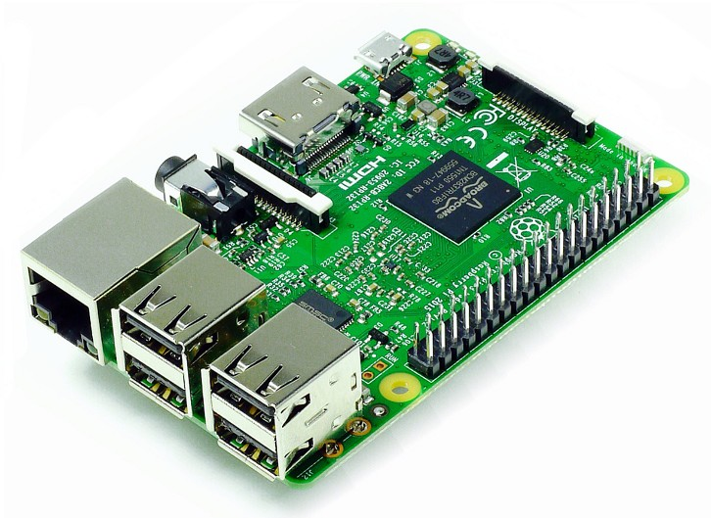
Windows 10 IoT on Respberry Pi 3
Windows for smaller devices
Universal Windows Platform (UWP)
Cloud based services

Slide 12
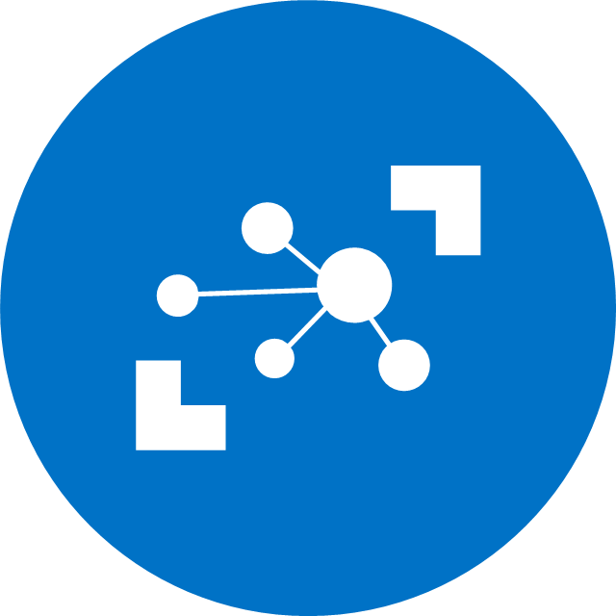
IoT Hub
Hyper scale IoT solution
Cloud-scale messaging
Two-way communication
Per-device authentication
Multi-protocol support
Cloud-scale gateway
Notes:
Designed for IoT
Connect up to 10 million devices
Cloud-scale messaging
Device-to-cloud and Cloud-to-device
Durable messages (at least once semantics)
Per-device authentication
Individual device identities and credentials
Multi-protocol support
Natively supports AMQP, HTTP, MQTT
Designed for extensibility to custom protocols
Service assisted communications
Secure bi-directional communication
Command and control
Cloud-facing telemetry ingestion
Delivery receipts, expired messages
Device communication errors
Connection multiplexing
Single device-cloud connection for all communications (C2D, D2C)
Multi-platform
Device SDKs available for multiple platforms (e.g. RTOS, Linux, Windows)
Multi-platform Service SDK

Slide 13
IoT Hub
Custom Protocol Gateway
(Cloud Service, VM)
Device
Custom Protocols
IoT Client
Raspberry Pi 3
Device
AMQP, MQTT, HTTPS
IoT Hub
Device Connectivity
IoT Client
IoT Client
Device
Field Gateway*
AMQP, MQTT, HTTPS
CoAP, AllJoyn, OPC
Device
IoT Client
Device
Data Path
Field Gateway
Custom Protocol Gateway
(Cloud Service, VM)
Optional solution component
OPC, HTTP, CoAP
Azure IoT solution component
CoAP, AllJoyn, OPC
Device
VPN/ExpressRoute
* Field Gateway is currently a concept that may represent Microsoft, 3rd party or custom capabilities at a hardware or software level

Slide 14
Demo

Slide 15
Stream Analytics
Uncover real time insights
Rapid Deployment
Mission critical reliability
Create real time alerts
High volume
Highly scalable
Notes:
Uncover real time insights
Perform real time analytics across multiple streams
Rapid Deployment
Use simple SQL syntax, auto distributed for scale
Mission critical reliability
Fully managed, low latency, high throughput
Create real time alerts
Flag alerts and alarms for attention
High volume
Analyze millions of data points per second
Highly scalable
Enterprise grade, predictable solution

Slide 16
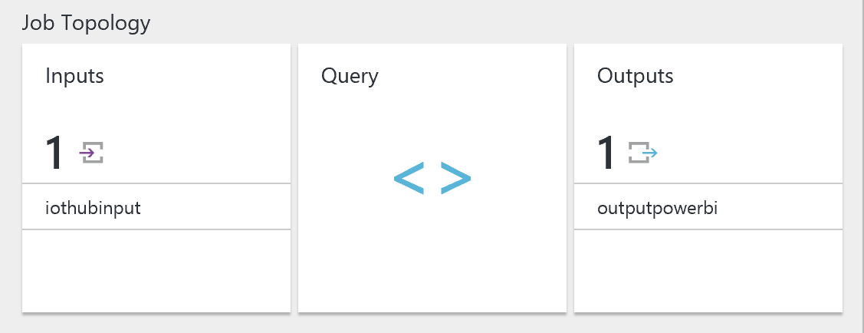
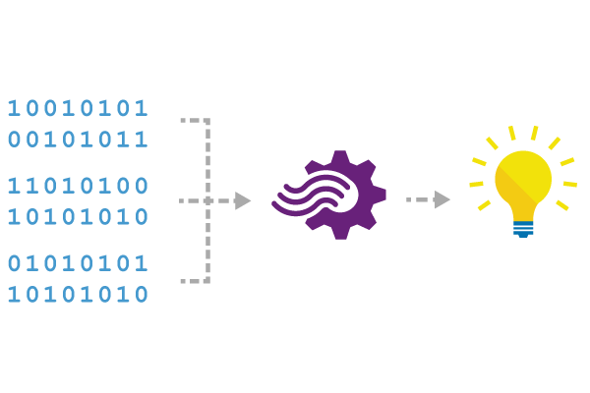

Stream Analytics
Ingress
Event Hub
IoT Hub
Blob storage
Reference / Augmentation
Machine Learning Scoring
Blob storage
Egress
Live Dashboards: PowerBI
Driving workflows: Event Hubs, Service Bus
Archiving and post analysis: Blob Storage, Document DB, Data Lake, SQL Server, Table Storage

Slide 17
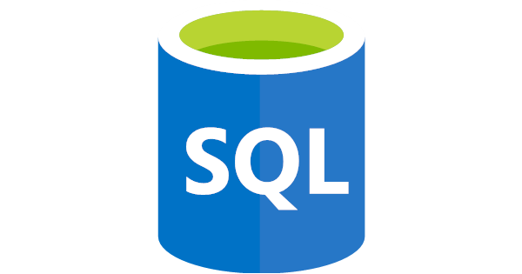


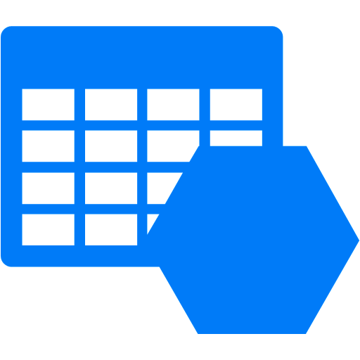
Data Storage
SQL Database
Data Lake
Document DB
Blob Storage

Slide 18
SQL Database
Built for SaaS and Enterprise applications
Predictable performance & pricing
99.99% availability built-in
Geo-replication and restore services
Secure and compliant for your sensitive data
Fully compatible with SQL Server 2014 databases
Notes:
Uncover real time insights
Perform real time analytics across multiple streams
Rapid Deployment
Use simple SQL syntax, auto distributed for scale
Mission critical reliability
Fully managed, low latency, high throughput
Create real time alerts
Flag alerts and alarms for attention
High volume
Analyze millions of data points per second
Highly scalable
Enterprise grade, predictable solution

Slide 19
Power BI
Real time capabilities
Secure access
Query data
Integrated systems
Highly accessible analytics
Cross platform support
Notes:
Real time capabilities
Ingest, analyze and display data as it happens
Secure access
Secure, live communication with data source
Query data
Intuitive, natural language query tool
Integrated systems
Integrate with other business systems and enrich device data with intelligence from other business systems, e.g. CRM, ERP
Highly accessible analytics
Cloud based dashboard and analytics tool
360º view of business KPI’s
Customize dashboards to address concerns and performance metrics
Cross platform support
View data via web platform, on any device
Pre-built dashboards
Utilize standard dashboards for rapid deployment, based on popular solution demands

Slide 20
The Solution

Slide 21
There is much more out there..

Slide 22




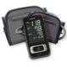

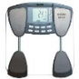





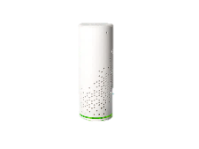
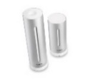
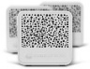



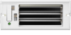
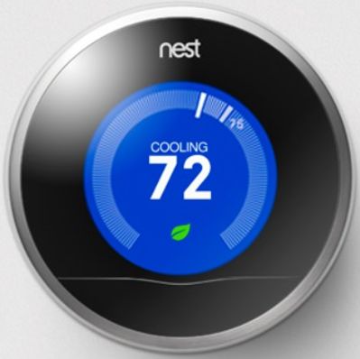
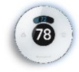


IoT Reference Architecture
Devices
(Linux, Windows, RTOS)
Device
Connectivity & Management
Analytics &
Operationalized Insights
Presentation &
Business Connectivity
Storage
SQL DB
Document DB
Storage
SQL Server
Cold Path Analysis
Health monitoring
Field Gateway
Protocol Adaptation
Event Hub
Data
Factory
Machine
Learning
Environmental sensors
IoT Hub
Mobile App
Hot Path Analysis
Web App
Air conditioning and temperature control
Logic App
Cloud Gateway
Stream Analytics
Notification Hub

Slide 23





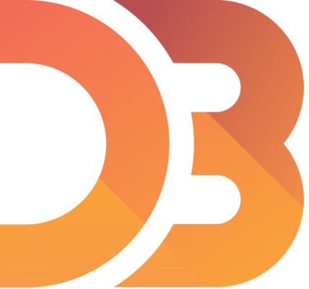











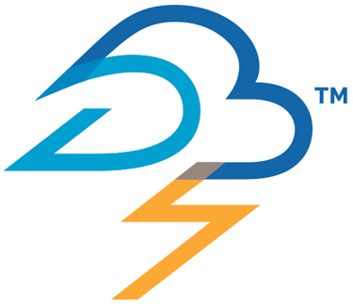
IoT Reference Architecture
Devices
(Linux, Windows, RTOS)
Device
Connectivity & Management
Analytics &
Operationalized Insights
Presentation &
Business Connectivity
Storage
Document DB
SQL DB
Apache Kafka
Storage
SQL Server
Cold Path Analysis
Health monitoring
Field Gateway
Protocol Adaptation
Event Hub
Data
Factory
Machine
Learning
IoT Hub
HDInsight
Spark
Environmental sensors
Mobile App
Apache Kafka
Hot Path Analysis
Web App
Air conditioning and temperature control
Apache Spark
Logic App
HDInsight
Spark/Storm
Cloud Gateway
Stream Analytics
Apache Storm
Notification Hub

Slide 24
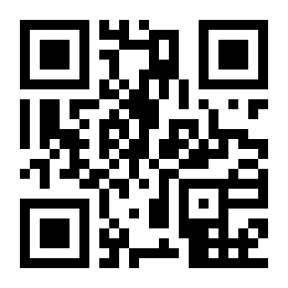
Gracias
http://aka.ms/mts34

